Slide 1



What we know
(don’t)
^
… about being productive and finding meaning at work
dishopch@msu.edu
Cdishop
Christopher R. Dishop

Slide 2
Agenda
Selection
Teams
Methods
Meaningful
Work
Performance
Diversity

Slide 3
Agenda
What we know
Selection
Teams
Methods
Meaningful
Work
Performance
Diversity

Slide 4
Agenda
What we know
Selection
Teams
Methods
Meaningful
Work
Performance
Diversity
What we don’t know

Slide 5
Agenda
MSU | Grad School | Career Path

Slide 6
Caveat
Correlational. External validity.
Low on data, high on buzzwords. I was going to present my dissertation
But I was asked to keep it basic. So I’m keeping it basic.

Slide 7
MEANINGFUL WORK

Slide 8
MEANINGFUL WORK
- Engaged
- Satisfied

Slide 9
Meaningful Work
What we know

Slide 10
Meaningful Work
What we know
Job Characteristics Model

Slide 11
Meaningful Work
Autonomy
Identity
Significance
Feedback
Skill Variety
What we know

Slide 12
Meaningful Work
Autonomy
Identity
Significance
Feedback
Skill Variety
What we know

Slide 13
Meaningful Work
Autonomy
Identity
Significance
Feedback
Skill Variety
What we know

Slide 14
Meaningful Work
Autonomy
Identity
Significance
Feedback
Skill Variety
What we know

Slide 15
Meaningful Work
Autonomy
Identity
Significance
Feedback
Skill Variety
What we know

Slide 16
Meaningful Work
Autonomy
Identity
Significance
Feedback
Skill Variety
What we know

Slide 17
Meaningful Work
Autonomy
Identity
Significance
Feedback
Skill Variety
Uniquely Valuable
What we know

Slide 18

Meaningful Work
Autonomy
Identity
Significance
Feedback
Skill Variety
Uniquely Valuable
What we know

Slide 19
Meaningful Work
Autonomy
Identity
Significance
Feedback
Skill Variety
Uniquely Valuable
What we know
Notes:
https://www.youtube.com/watch?v=cGfLZWQUD4g
https://www.youtube.com/watch?v=_woAZTe5YBw

Slide 20
Meaningful Work
What we know
☹️

Slide 21
Meaningful Work
Follow your passion
What we know
☹️

Slide 22
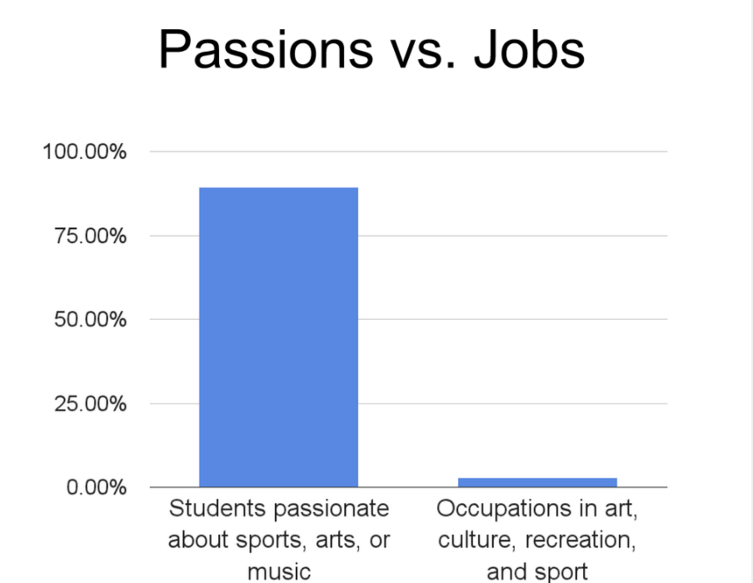
Meaningful Work
Follow your passion
What we know
☹️

Slide 23
Meaningful Work
Follow your passion
What we know
☹️
“We are all passionate about music, art, sex, and sports. There are no jobs in those industries.” - Freakonomics

Slide 24
Meaningful Work
Follow your passion
Commute time
What we know
☹️
☹️

Slide 25
Meaningful Work
What we don’t know

Slide 26


Meaningful Work
Limits
Technology & Social Media
What we don’t know

Slide 27
Individual Performance & Career Success

Slide 28
Individual Performance & Career Success
- Effective
- Ladder

Slide 29
Individual Success
What we know
Notes:
Agent. Environment.
Self Regulation.
Sklls – learning, writing, communicating

Slide 30
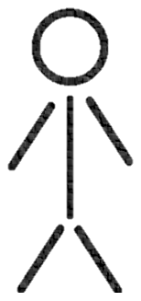
Individual Success
What we know
Notes:
Self regulation. Connects person and environment. Something I study. What is the link between someone performing, the feedback he gets from the envioronment, and so on.

Slide 31
Individual Success
What we know
Cognitive Ability
Notes:
Self regulation. Connects person and environment. Something I study. What is the link between someone performing, the feedback he gets from the envioronment, and so on.

Slide 32
Individual Success
What we know
Cognitive Ability
Assertive
Optimism
Conscientiousness
Notes:
Self regulation. Connects person and environment. Something I study. What is the link between someone performing, the feedback he gets from the envioronment, and so on.

Slide 33
Individual Success
What we know
Cognitive Ability
Assertive
Optimism
Conscientiousness
Learning, Writing, Communicating
Notes:
Self regulation. Connects person and environment. Something I study. What is the link between someone performing, the feedback he gets from the envioronment, and so on.

Slide 34
Individual Success
What we know
Cognitive Ability
Assertive
Optimism
Conscientiousness
Learning, Writing, Communicating
Parents
Social Support
Climate
Notes:
Self regulation. Connects person and environment. Something I study. What is the link between someone performing, the feedback he gets from the envioronment, and so on.

Slide 35
Individual Success
What we know
Human Capital Investments
Cognitive Ability
Assertive
Optimism
Conscientiousness
Learning, Writing, Communicating
Parents
Social Support
Climate
Notes:
Self regulation. Connects person and environment. Something I study. What is the link between someone performing, the feedback he gets from the envioronment, and so on.

Slide 36
Individual Success
What we know
Environment
State
Notes:
Self regulation. Connects person and environment. Something I study. What is the link between someone performing, the feedback he gets from the envioronment, and so on.
Goals. Rewards

Slide 37
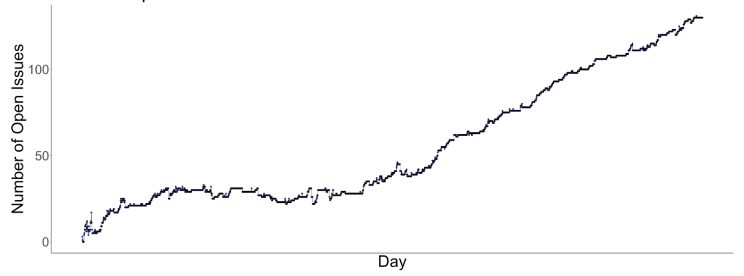
Individual Success
What we know
Notes:
Self regulation. Connects person and environment. Something I study. What is the link between someone performing, the feedback he gets from the envioronment, and so on.

Slide 38
Individual Success
What we know
Environment
State
Notes:
Monitor a state. I don’t mean conscieously perceiving at all times. What I really mean is monitoring discrepancies. You monitor your temperature. You don’t check it with a thermometer every hour…but when your temperature is 100 you very much notice.

Slide 39
Individual Success
What we don’t know
Notes:
Self regulation. Connects person and environment. Something I study. What is the link between someone performing, the feedback he gets from the envioronment, and so on.

Slide 40
Individual Success
Translating
What we don’t know

Slide 41
Individual Success
Translating (Scientist Practitioner Gap)
What we don’t know

Slide 42
Individual Success
Translating (Scientist Practitioner Gap)
Protean & Boundaryless
What we don’t know

Slide 43
Team Performance

Slide 44
Team Performance
- Effective

Slide 45
Team Performance
What we know
Notes:
Henry Ford broke the assembly task into 84 discrete steps and trained workers to do just one step to increase his factories’ productivity. This reduced the production time of a car from 12.5 hours to 93 minutes. Production figures compiled from the Model T Comprehensive Encyclopedia show that production before the assembly line was introduced in 1913 averaged 68,773 cars per year. In 1913, production increased to 170,211 cars in a year (McCalley, 1989).
Each worker focuses on one task and specializes
No transition times
By focusing on one task, you can be creative and change it slightly to make it better

Slide 46
Team Performance
Process Loss
What we know
Notes:
Henry Ford broke the assembly task into 84 discrete steps and trained workers to do just one step to increase his factories’ productivity. This reduced the production time of a car from 12.5 hours to 93 minutes. Production figures compiled from the Model T Comprehensive Encyclopedia show that production before the assembly line was introduced in 1913 averaged 68,773 cars per year. In 1913, production increased to 170,211 cars in a year (McCalley, 1989).
Each worker focuses on one task and specializes
No transition times
By focusing on one task, you can be creative and change it slightly to make it better

Slide 47
Team Performance
Process Loss
What we know
Notes:
Henry Ford broke the assembly task into 84 discrete steps and trained workers to do just one step to increase his factories’ productivity. This reduced the production time of a car from 12.5 hours to 93 minutes. Production figures compiled from the Model T Comprehensive Encyclopedia show that production before the assembly line was introduced in 1913 averaged 68,773 cars per year. In 1913, production increased to 170,211 cars in a year (McCalley, 1989).
Each worker focuses on one task and specializes
No transition times
By focusing on one task, you can be creative and change it slightly to make it better

Slide 48

Team Performance
Process Loss
Division Of Labor
What we know
Notes:
Henry Ford broke the assembly task into 84 discrete steps and trained workers to do just one step to increase his factories’ productivity. This reduced the production time of a car from 12.5 hours to 93 minutes. Production figures compiled from the Model T Comprehensive Encyclopedia show that production before the assembly line was introduced in 1913 averaged 68,773 cars per year. In 1913, production increased to 170,211 cars in a year (McCalley, 1989).
Each worker focuses on one task and specializes
No transition times
By focusing on one task, you can be creative and change it slightly to make it better

Slide 49
Team Performance
Process Loss
Division Of Labor
What we know
Notes:
Henry Ford broke the assembly task into 84 discrete steps and trained workers to do just one step to increase his factories’ productivity. This reduced the production time of a car from 12.5 hours to 93 minutes. Production figures compiled from the Model T Comprehensive Encyclopedia show that production before the assembly line was introduced in 1913 averaged 68,773 cars per year. In 1913, production increased to 170,211 cars in a year (McCalley, 1989).
Each worker focuses on one task and specializes
No transition times
By focusing on one task, you can be creative and change it slightly to make it better

Slide 50
Team Performance
Process Loss
Division Of Labor
What we know
Hours to production
Notes:
Henry Ford broke the assembly task into 84 discrete steps and trained workers to do just one step to increase his factories’ productivity. This reduced the production time of a car from 12.5 hours to 93 minutes. Production figures compiled from the Model T Comprehensive Encyclopedia show that production before the assembly line was introduced in 1913 averaged 68,773 cars per year. In 1913, production increased to 170,211 cars in a year (McCalley, 1989).
Each worker focuses on one task and specializes
No transition times
By focusing on one task, you can be creative and change it slightly to make it better

Slide 51
Team Performance
Process Loss
Division Of Labor
What we know
13
Hours to production
1
Notes:
Henry Ford broke the assembly task into 84 discrete steps and trained workers to do just one step to increase his factories’ productivity. This reduced the production time of a car from 12.5 hours to 93 minutes. Production figures compiled from the Model T Comprehensive Encyclopedia show that production before the assembly line was introduced in 1913 averaged 68,773 cars per year. In 1913, production increased to 170,211 cars in a year (McCalley, 1989).
Each worker focuses on one task and specializes
No transition times
By focusing on one task, you can be creative and change it slightly to make it better

Slide 52
Team Performance
Process Loss
Division Of Labor
What we know
13
No
Assembly
Line
Hours to production
1
Notes:
Henry Ford broke the assembly task into 84 discrete steps and trained workers to do just one step to increase his factories’ productivity. This reduced the production time of a car from 12.5 hours to 93 minutes. Production figures compiled from the Model T Comprehensive Encyclopedia show that production before the assembly line was introduced in 1913 averaged 68,773 cars per year. In 1913, production increased to 170,211 cars in a year (McCalley, 1989).
Each worker focuses on one task and specializes
No transition times
By focusing on one task, you can be creative and change it slightly to make it better

Slide 53
Team Performance
Process Loss
Division Of Labor
What we know
13
No
Assembly
Line
Hours to production
1
Assembly Line
Notes:
Henry Ford broke the assembly task into 84 discrete steps and trained workers to do just one step to increase his factories’ productivity. This reduced the production time of a car from 12.5 hours to 93 minutes. Production figures compiled from the Model T Comprehensive Encyclopedia show that production before the assembly line was introduced in 1913 averaged 68,773 cars per year. In 1913, production increased to 170,211 cars in a year (McCalley, 1989).
Each worker focuses on one task and specializes
No transition times
By focusing on one task, you can be creative and change it slightly to make it better

Slide 54
Team Performance
Process Loss
Division Of Labor
Wisdom Of Crowds
What we know
Notes:
Henry Ford broke the assembly task into 84 discrete steps and trained workers to do just one step to increase his factories’ productivity. This reduced the production time of a car from 12.5 hours to 93 minutes. Production figures compiled from the Model T Comprehensive Encyclopedia show that production before the assembly line was introduced in 1913 averaged 68,773 cars per year. In 1913, production increased to 170,211 cars in a year (McCalley, 1989).
Each worker focuses on one task and specializes
No transition times
By focusing on one task, you can be creative and change it slightly to make it better

Slide 55

Team Performance
Process Loss
Division Of Labor
Wisdom Of Crowds
What we know
Notes:
Henry Ford broke the assembly task into 84 discrete steps and trained workers to do just one step to increase his factories’ productivity. This reduced the production time of a car from 12.5 hours to 93 minutes. Production figures compiled from the Model T Comprehensive Encyclopedia show that production before the assembly line was introduced in 1913 averaged 68,773 cars per year. In 1913, production increased to 170,211 cars in a year (McCalley, 1989).
Each worker focuses on one task and specializes
No transition times
By focusing on one task, you can be creative and change it slightly to make it better

Slide 56
Team Performance
Process Loss
Division Of Labor
Wisdom Of Crowds
What we know
1900
2000
1100
1200
Notes:
Henry Ford broke the assembly task into 84 discrete steps and trained workers to do just one step to increase his factories’ productivity. This reduced the production time of a car from 12.5 hours to 93 minutes. Production figures compiled from the Model T Comprehensive Encyclopedia show that production before the assembly line was introduced in 1913 averaged 68,773 cars per year. In 1913, production increased to 170,211 cars in a year (McCalley, 1989).
Each worker focuses on one task and specializes
No transition times
By focusing on one task, you can be creative and change it slightly to make it better

Slide 57
Team Performance
Process Loss
Division Of Labor
Wisdom Of Crowds
What we know
1900
2000
1100
1200
Notes:
Henry Ford broke the assembly task into 84 discrete steps and trained workers to do just one step to increase his factories’ productivity. This reduced the production time of a car from 12.5 hours to 93 minutes. Production figures compiled from the Model T Comprehensive Encyclopedia show that production before the assembly line was introduced in 1913 averaged 68,773 cars per year. In 1913, production increased to 170,211 cars in a year (McCalley, 1989).
Each worker focuses on one task and specializes
No transition times
By focusing on one task, you can be creative and change it slightly to make it better

Slide 58
Team Performance
Process Loss
Division Of Labor
Wisdom Of Crowds
What we know
1900
2000
1100
1200
1550
Notes:
Henry Ford broke the assembly task into 84 discrete steps and trained workers to do just one step to increase his factories’ productivity. This reduced the production time of a car from 12.5 hours to 93 minutes. Production figures compiled from the Model T Comprehensive Encyclopedia show that production before the assembly line was introduced in 1913 averaged 68,773 cars per year. In 1913, production increased to 170,211 cars in a year (McCalley, 1989).
Each worker focuses on one task and specializes
No transition times
By focusing on one task, you can be creative and change it slightly to make it better

Slide 59
Team Performance
Process Loss
Division Of Labor
Wisdom Of Crowds
What we know
1900
2000
1100
1200
1550 =
Notes:
Henry Ford broke the assembly task into 84 discrete steps and trained workers to do just one step to increase his factories’ productivity. This reduced the production time of a car from 12.5 hours to 93 minutes. Production figures compiled from the Model T Comprehensive Encyclopedia show that production before the assembly line was introduced in 1913 averaged 68,773 cars per year. In 1913, production increased to 170,211 cars in a year (McCalley, 1989).
Each worker focuses on one task and specializes
No transition times
By focusing on one task, you can be creative and change it slightly to make it better

Slide 60
Team Performance
Process Loss
Division Of Labor
Wisdom Of Crowds
Diversity
What we know
Notes:
Henry Ford broke the assembly task into 84 discrete steps and trained workers to do just one step to increase his factories’ productivity. This reduced the production time of a car from 12.5 hours to 93 minutes. Production figures compiled from the Model T Comprehensive Encyclopedia show that production before the assembly line was introduced in 1913 averaged 68,773 cars per year. In 1913, production increased to 170,211 cars in a year (McCalley, 1989).
Each worker focuses on one task and specializes
No transition times
By focusing on one task, you can be creative and change it slightly to make it better

Slide 61


Team Performance
Process Loss
Division Of Labor
Wisdom Of Crowds
Diversity
What we know
Notes:
Henry Ford broke the assembly task into 84 discrete steps and trained workers to do just one step to increase his factories’ productivity. This reduced the production time of a car from 12.5 hours to 93 minutes. Production figures compiled from the Model T Comprehensive Encyclopedia show that production before the assembly line was introduced in 1913 averaged 68,773 cars per year. In 1913, production increased to 170,211 cars in a year (McCalley, 1989).
Each worker focuses on one task and specializes
No transition times
By focusing on one task, you can be creative and change it slightly to make it better

Slide 62
Team Performance
Process Loss
Division Of Labor
Wisdom Of Crowds
Diversity
Levers
What we know
Notes:
Henry Ford broke the assembly task into 84 discrete steps and trained workers to do just one step to increase his factories’ productivity. This reduced the production time of a car from 12.5 hours to 93 minutes. Production figures compiled from the Model T Comprehensive Encyclopedia show that production before the assembly line was introduced in 1913 averaged 68,773 cars per year. In 1913, production increased to 170,211 cars in a year (McCalley, 1989).
Each worker focuses on one task and specializes
No transition times
By focusing on one task, you can be creative and change it slightly to make it better

Slide 63
Team Performance
Process Loss
Division Of Labor
Wisdom Of Crowds
Diversity
Levers
What we know
Shared Vision | Transactive Memory | Leadership
Notes:
Henry Ford broke the assembly task into 84 discrete steps and trained workers to do just one step to increase his factories’ productivity. This reduced the production time of a car from 12.5 hours to 93 minutes. Production figures compiled from the Model T Comprehensive Encyclopedia show that production before the assembly line was introduced in 1913 averaged 68,773 cars per year. In 1913, production increased to 170,211 cars in a year (McCalley, 1989).
Each worker focuses on one task and specializes
No transition times
By focusing on one task, you can be creative and change it slightly to make it better

Slide 64
Team Performance
Process Loss
Division Of Labor
Wisdom Of Crowds
Diversity
Levers
Cooperation
What we know
Notes:
Henry Ford broke the assembly task into 84 discrete steps and trained workers to do just one step to increase his factories’ productivity. This reduced the production time of a car from 12.5 hours to 93 minutes. Production figures compiled from the Model T Comprehensive Encyclopedia show that production before the assembly line was introduced in 1913 averaged 68,773 cars per year. In 1913, production increased to 170,211 cars in a year (McCalley, 1989).
Each worker focuses on one task and specializes
No transition times
By focusing on one task, you can be creative and change it slightly to make it better

Slide 65
Dishop, C. R., & DeShon, R. P. (2020). What is the critical mass of help? A potential resolution to a paradox on citizenship and organizational performance. Computational & Mathematical Organization Theory, 1-15.
Team Performance
What we know
Notes:
Henry Ford broke the assembly task into 84 discrete steps and trained workers to do just one step to increase his factories’ productivity. This reduced the production time of a car from 12.5 hours to 93 minutes. Production figures compiled from the Model T Comprehensive Encyclopedia show that production before the assembly line was introduced in 1913 averaged 68,773 cars per year. In 1913, production increased to 170,211 cars in a year (McCalley, 1989).
Each worker focuses on one task and specializes
No transition times
By focusing on one task, you can be creative and change it slightly to make it better

Slide 66
Dishop, C. R., & DeShon, R. P. (2020). What is the critical mass of help? A potential resolution to a paradox on citizenship and organizational performance. Computational & Mathematical Organization Theory, 1-15.
Team Performance
What we know
Helping
Performing
Notes:
Henry Ford broke the assembly task into 84 discrete steps and trained workers to do just one step to increase his factories’ productivity. This reduced the production time of a car from 12.5 hours to 93 minutes. Production figures compiled from the Model T Comprehensive Encyclopedia show that production before the assembly line was introduced in 1913 averaged 68,773 cars per year. In 1913, production increased to 170,211 cars in a year (McCalley, 1989).
Each worker focuses on one task and specializes
No transition times
By focusing on one task, you can be creative and change it slightly to make it better

Slide 67
Dishop, C. R., & DeShon, R. P. (2020). What is the critical mass of help? A potential resolution to a paradox on citizenship and organizational performance. Computational & Mathematical Organization Theory, 1-15.
Team Performance
What we know
Helping
Performing
Collective Performance
Notes:
Henry Ford broke the assembly task into 84 discrete steps and trained workers to do just one step to increase his factories’ productivity. This reduced the production time of a car from 12.5 hours to 93 minutes. Production figures compiled from the Model T Comprehensive Encyclopedia show that production before the assembly line was introduced in 1913 averaged 68,773 cars per year. In 1913, production increased to 170,211 cars in a year (McCalley, 1989).
Each worker focuses on one task and specializes
No transition times
By focusing on one task, you can be creative and change it slightly to make it better

Slide 68
Dishop, C. R., & DeShon, R. P. (2020). What is the critical mass of help? A potential resolution to a paradox on citizenship and organizational performance. Computational & Mathematical Organization Theory, 1-15.
Team Performance
What we know
Helping
Performing
Collective Performance
# People Helping
Notes:
Henry Ford broke the assembly task into 84 discrete steps and trained workers to do just one step to increase his factories’ productivity. This reduced the production time of a car from 12.5 hours to 93 minutes. Production figures compiled from the Model T Comprehensive Encyclopedia show that production before the assembly line was introduced in 1913 averaged 68,773 cars per year. In 1913, production increased to 170,211 cars in a year (McCalley, 1989).
Each worker focuses on one task and specializes
No transition times
By focusing on one task, you can be creative and change it slightly to make it better

Slide 69
Dishop, C. R., & DeShon, R. P. (2020). What is the critical mass of help? A potential resolution to a paradox on citizenship and organizational performance. Computational & Mathematical Organization Theory, 1-15.
Team Performance
What we know
Helping
Performing
Collective Performance
# People Helping
Notes:
Henry Ford broke the assembly task into 84 discrete steps and trained workers to do just one step to increase his factories’ productivity. This reduced the production time of a car from 12.5 hours to 93 minutes. Production figures compiled from the Model T Comprehensive Encyclopedia show that production before the assembly line was introduced in 1913 averaged 68,773 cars per year. In 1913, production increased to 170,211 cars in a year (McCalley, 1989).
Each worker focuses on one task and specializes
No transition times
By focusing on one task, you can be creative and change it slightly to make it better

Slide 70
Dishop, C. R., & DeShon, R. P. (2020). What is the critical mass of help? A potential resolution to a paradox on citizenship and organizational performance. Computational & Mathematical Organization Theory, 1-15.
Team Performance
What we know
Helping
Performing
Collective Performance
# People Helping
Notes:
Henry Ford broke the assembly task into 84 discrete steps and trained workers to do just one step to increase his factories’ productivity. This reduced the production time of a car from 12.5 hours to 93 minutes. Production figures compiled from the Model T Comprehensive Encyclopedia show that production before the assembly line was introduced in 1913 averaged 68,773 cars per year. In 1913, production increased to 170,211 cars in a year (McCalley, 1989).
Each worker focuses on one task and specializes
No transition times
By focusing on one task, you can be creative and change it slightly to make it better

Slide 71
Dishop, C. R., & DeShon, R. P. (2020). What is the critical mass of help? A potential resolution to a paradox on citizenship and organizational performance. Computational & Mathematical Organization Theory, 1-15.
Team Performance
What we know
Helping
Performing
Collective Performance
# People Helping
Notes:
Henry Ford broke the assembly task into 84 discrete steps and trained workers to do just one step to increase his factories’ productivity. This reduced the production time of a car from 12.5 hours to 93 minutes. Production figures compiled from the Model T Comprehensive Encyclopedia show that production before the assembly line was introduced in 1913 averaged 68,773 cars per year. In 1913, production increased to 170,211 cars in a year (McCalley, 1989).
Each worker focuses on one task and specializes
No transition times
By focusing on one task, you can be creative and change it slightly to make it better

Slide 72
Dishop, C. R., & DeShon, R. P. (2020). What is the critical mass of help? A potential resolution to a paradox on citizenship and organizational performance. Computational & Mathematical Organization Theory, 1-15.
Team Performance
What we know
Helping
Performing
Collective Performance
# People Helping
Notes:
Henry Ford broke the assembly task into 84 discrete steps and trained workers to do just one step to increase his factories’ productivity. This reduced the production time of a car from 12.5 hours to 93 minutes. Production figures compiled from the Model T Comprehensive Encyclopedia show that production before the assembly line was introduced in 1913 averaged 68,773 cars per year. In 1913, production increased to 170,211 cars in a year (McCalley, 1989).
Each worker focuses on one task and specializes
No transition times
By focusing on one task, you can be creative and change it slightly to make it better

Slide 73
Dishop, C. R., & DeShon, R. P. (2020). What is the critical mass of help? A potential resolution to a paradox on citizenship and organizational performance. Computational & Mathematical Organization Theory, 1-15.
Team Performance
What we know
Helping
Performing
Collective Performance
# People Helping
Notes:
Henry Ford broke the assembly task into 84 discrete steps and trained workers to do just one step to increase his factories’ productivity. This reduced the production time of a car from 12.5 hours to 93 minutes. Production figures compiled from the Model T Comprehensive Encyclopedia show that production before the assembly line was introduced in 1913 averaged 68,773 cars per year. In 1913, production increased to 170,211 cars in a year (McCalley, 1989).
Each worker focuses on one task and specializes
No transition times
By focusing on one task, you can be creative and change it slightly to make it better

Slide 74
Dishop, C. R., & DeShon, R. P. (2020). What is the critical mass of help? A potential resolution to a paradox on citizenship and organizational performance. Computational & Mathematical Organization Theory, 1-15.
Team Performance
What we know
Helping
Performing
Collective Performance
# People Helping
Notes:
Henry Ford broke the assembly task into 84 discrete steps and trained workers to do just one step to increase his factories’ productivity. This reduced the production time of a car from 12.5 hours to 93 minutes. Production figures compiled from the Model T Comprehensive Encyclopedia show that production before the assembly line was introduced in 1913 averaged 68,773 cars per year. In 1913, production increased to 170,211 cars in a year (McCalley, 1989).
Each worker focuses on one task and specializes
No transition times
By focusing on one task, you can be creative and change it slightly to make it better

Slide 75
Team Performance
What we don’t know
Notes:
Henry Ford broke the assembly task into 84 discrete steps and trained workers to do just one step to increase his factories’ productivity. This reduced the production time of a car from 12.5 hours to 93 minutes. Production figures compiled from the Model T Comprehensive Encyclopedia show that production before the assembly line was introduced in 1913 averaged 68,773 cars per year. In 1913, production increased to 170,211 cars in a year (McCalley, 1989).
Each worker focuses on one task and specializes
No transition times
By focusing on one task, you can be creative and change it slightly to make it better

Slide 76
Team Performance
Beyond lab
What we don’t know
Notes:
Henry Ford broke the assembly task into 84 discrete steps and trained workers to do just one step to increase his factories’ productivity. This reduced the production time of a car from 12.5 hours to 93 minutes. Production figures compiled from the Model T Comprehensive Encyclopedia show that production before the assembly line was introduced in 1913 averaged 68,773 cars per year. In 1913, production increased to 170,211 cars in a year (McCalley, 1989).
Each worker focuses on one task and specializes
No transition times
By focusing on one task, you can be creative and change it slightly to make it better

Slide 77
Team Performance
Beyond lab
Congruent explanations
What we don’t know
Notes:
This is the nice way to say it. The mean way to say it is that there is a tendency to provide explanations that are abstract, boring, and unhelpful. Not intellectually deep.

Slide 78
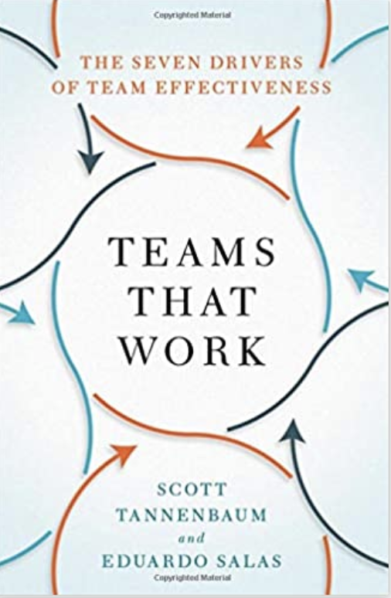
Team Performance
Beyond lab
Congruent explanations
What we don’t know

Slide 79
Team Performance
What we don’t know
Lever | Description
Conditions | Is the context favorable to performing well?

Slide 80
Methods

Slide 81
Methods
Scale Development
Measurement Invariance
Meta Analysis
Networks
Dynamics
Computational Modeling
Notes:
Henry Ford broke the assembly task into 84 discrete steps and trained workers to do just one step to increase his factories’ productivity. This reduced the production time of a car from 12.5 hours to 93 minutes. Production figures compiled from the Model T Comprehensive Encyclopedia show that production before the assembly line was introduced in 1913 averaged 68,773 cars per year. In 1913, production increased to 170,211 cars in a year (McCalley, 1989).
Each worker focuses on one task and specializes
No transition times
By focusing on one task, you can be creative and change it slightly to make it better

Slide 82
Methods
Scale Development
Notes:
Henry Ford broke the assembly task into 84 discrete steps and trained workers to do just one step to increase his factories’ productivity. This reduced the production time of a car from 12.5 hours to 93 minutes. Production figures compiled from the Model T Comprehensive Encyclopedia show that production before the assembly line was introduced in 1913 averaged 68,773 cars per year. In 1913, production increased to 170,211 cars in a year (McCalley, 1989).
Each worker focuses on one task and specializes
No transition times
By focusing on one task, you can be creative and change it slightly to make it better

Slide 83

Methods
Scale Development
Notes:
Jingle jangle. Grit, self esteem, self efficacy, resilience

Slide 84
Methods
Scale Development
Notes:
Henry Ford broke the assembly task into 84 discrete steps and trained workers to do just one step to increase his factories’ productivity. This reduced the production time of a car from 12.5 hours to 93 minutes. Production figures compiled from the Model T Comprehensive Encyclopedia show that production before the assembly line was introduced in 1913 averaged 68,773 cars per year. In 1913, production increased to 170,211 cars in a year (McCalley, 1989).
Each worker focuses on one task and specializes
No transition times
By focusing on one task, you can be creative and change it slightly to make it better

Slide 85
Methods
Meta Analysis
Notes:
Henry Ford broke the assembly task into 84 discrete steps and trained workers to do just one step to increase his factories’ productivity. This reduced the production time of a car from 12.5 hours to 93 minutes. Production figures compiled from the Model T Comprehensive Encyclopedia show that production before the assembly line was introduced in 1913 averaged 68,773 cars per year. In 1913, production increased to 170,211 cars in a year (McCalley, 1989).
Each worker focuses on one task and specializes
No transition times
By focusing on one task, you can be creative and change it slightly to make it better

Slide 86
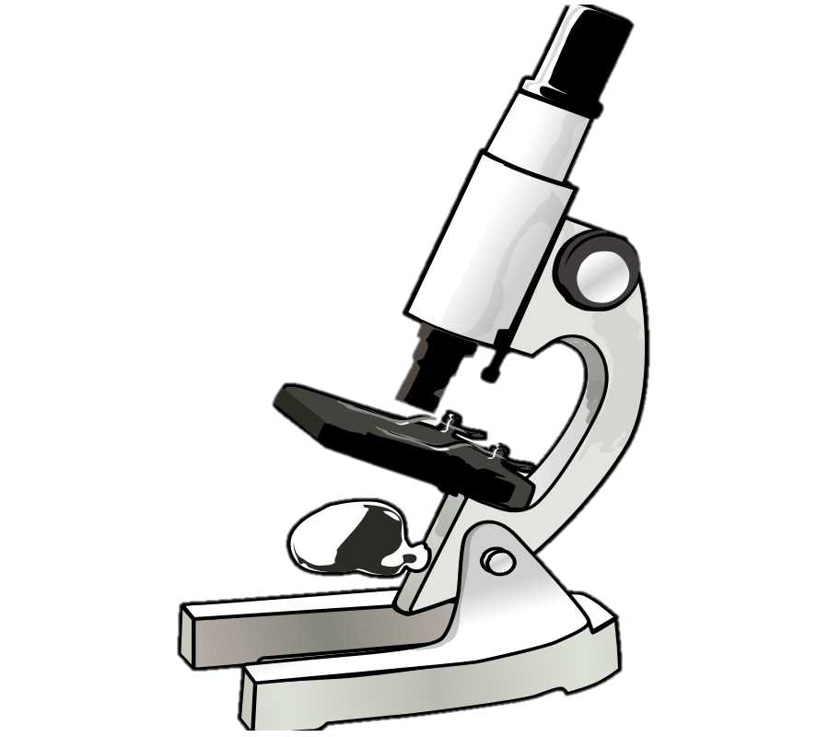
Autonomy => Satisfaction
Methods
Meta Analysis
Notes:
Henry Ford broke the assembly task into 84 discrete steps and trained workers to do just one step to increase his factories’ productivity. This reduced the production time of a car from 12.5 hours to 93 minutes. Production figures compiled from the Model T Comprehensive Encyclopedia show that production before the assembly line was introduced in 1913 averaged 68,773 cars per year. In 1913, production increased to 170,211 cars in a year (McCalley, 1989).
Each worker focuses on one task and specializes
No transition times
By focusing on one task, you can be creative and change it slightly to make it better

Slide 87

Autonomy => Satisfaction
Methods
Meta Analysis
Autonomy => Satisfaction
Notes:
Henry Ford broke the assembly task into 84 discrete steps and trained workers to do just one step to increase his factories’ productivity. This reduced the production time of a car from 12.5 hours to 93 minutes. Production figures compiled from the Model T Comprehensive Encyclopedia show that production before the assembly line was introduced in 1913 averaged 68,773 cars per year. In 1913, production increased to 170,211 cars in a year (McCalley, 1989).
Each worker focuses on one task and specializes
No transition times
By focusing on one task, you can be creative and change it slightly to make it better

Slide 88

Autonomy => Satisfaction
Methods
Meta Analysis
Autonomy => Satisfaction
Autonomy => Satisfaction
Notes:
Henry Ford broke the assembly task into 84 discrete steps and trained workers to do just one step to increase his factories’ productivity. This reduced the production time of a car from 12.5 hours to 93 minutes. Production figures compiled from the Model T Comprehensive Encyclopedia show that production before the assembly line was introduced in 1913 averaged 68,773 cars per year. In 1913, production increased to 170,211 cars in a year (McCalley, 1989).
Each worker focuses on one task and specializes
No transition times
By focusing on one task, you can be creative and change it slightly to make it better

Slide 89


Autonomy => Satisfaction
Methods
Meta Analysis
Autonomy => Satisfaction
Autonomy => Satisfaction
Autonomy => Satisfaction
Autonomy => Satisfaction
Notes:
Henry Ford broke the assembly task into 84 discrete steps and trained workers to do just one step to increase his factories’ productivity. This reduced the production time of a car from 12.5 hours to 93 minutes. Production figures compiled from the Model T Comprehensive Encyclopedia show that production before the assembly line was introduced in 1913 averaged 68,773 cars per year. In 1913, production increased to 170,211 cars in a year (McCalley, 1989).
Each worker focuses on one task and specializes
No transition times
By focusing on one task, you can be creative and change it slightly to make it better

Slide 90

Autonomy => Satisfaction
Autonomy => Satisfaction
Autonomy => Satisfaction
Autonomy => Satisfaction
Autonomy => Satisfaction
Autonomy => Satisfaction
Notes:
Henry Ford broke the assembly task into 84 discrete steps and trained workers to do just one step to increase his factories’ productivity. This reduced the production time of a car from 12.5 hours to 93 minutes. Production figures compiled from the Model T Comprehensive Encyclopedia show that production before the assembly line was introduced in 1913 averaged 68,773 cars per year. In 1913, production increased to 170,211 cars in a year (McCalley, 1989).
Each worker focuses on one task and specializes
No transition times
By focusing on one task, you can be creative and change it slightly to make it better

Slide 91
Autonomy => Satisfaction
Autonomy => Satisfaction
Autonomy => Satisfaction
Autonomy => Satisfaction
=>
Autonomy => Satisfaction
Autonomy => Satisfaction

Slide 92
Methods
Dynamics

Slide 93
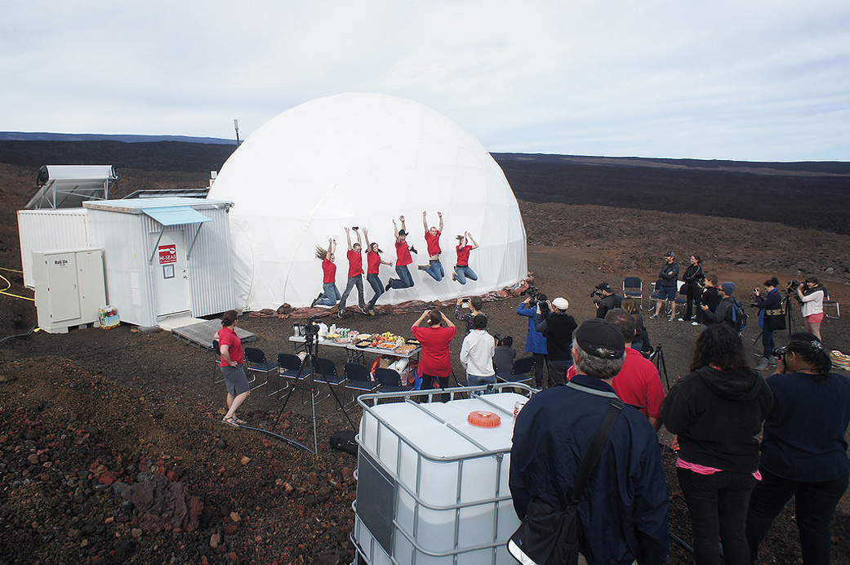

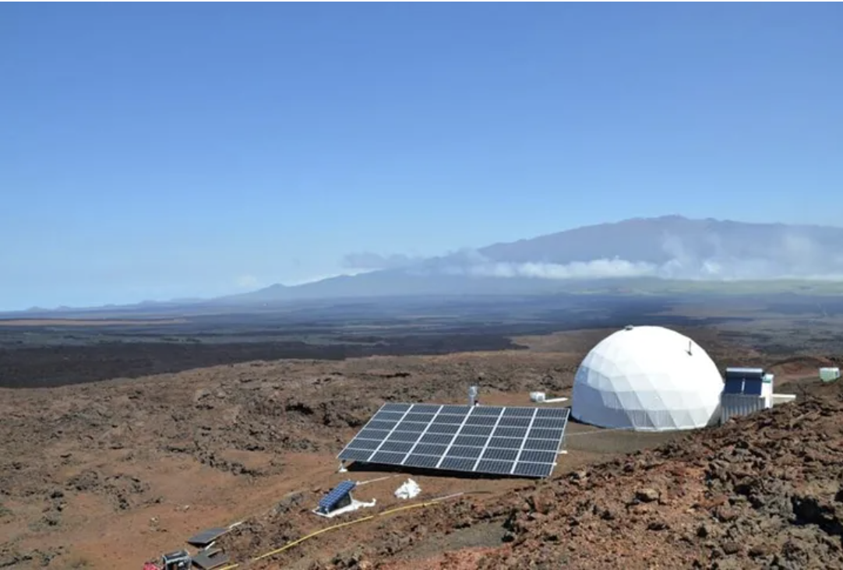

Slide 94
Methods
Computational Modeling
Notes:
Henry Ford broke the assembly task into 84 discrete steps and trained workers to do just one step to increase his factories’ productivity. This reduced the production time of a car from 12.5 hours to 93 minutes. Production figures compiled from the Model T Comprehensive Encyclopedia show that production before the assembly line was introduced in 1913 averaged 68,773 cars per year. In 1913, production increased to 170,211 cars in a year (McCalley, 1989).
Each worker focuses on one task and specializes
No transition times
By focusing on one task, you can be creative and change it slightly to make it better

Slide 95

Methods
Computational Modeling
Notes:
Henry Ford broke the assembly task into 84 discrete steps and trained workers to do just one step to increase his factories’ productivity. This reduced the production time of a car from 12.5 hours to 93 minutes. Production figures compiled from the Model T Comprehensive Encyclopedia show that production before the assembly line was introduced in 1913 averaged 68,773 cars per year. In 1913, production increased to 170,211 cars in a year (McCalley, 1989).
Each worker focuses on one task and specializes
No transition times
By focusing on one task, you can be creative and change it slightly to make it better

Slide 96
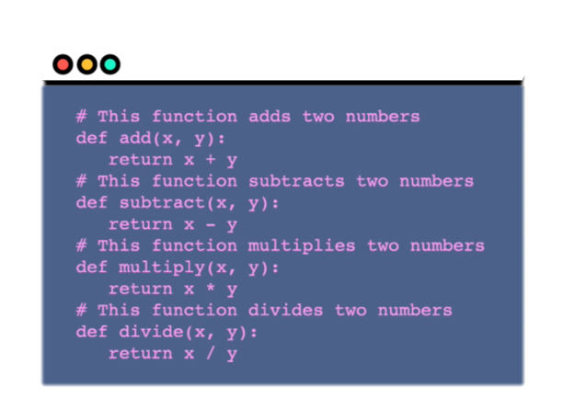
Methods
Computational Modeling
Notes:
https://www.washingtonpost.com/graphics/2020/world/corona-simulator/

Slide 97
Caveat
Notes:
Applied
Interviews
Leadership
Staffing or pay or group formation

Slide 98
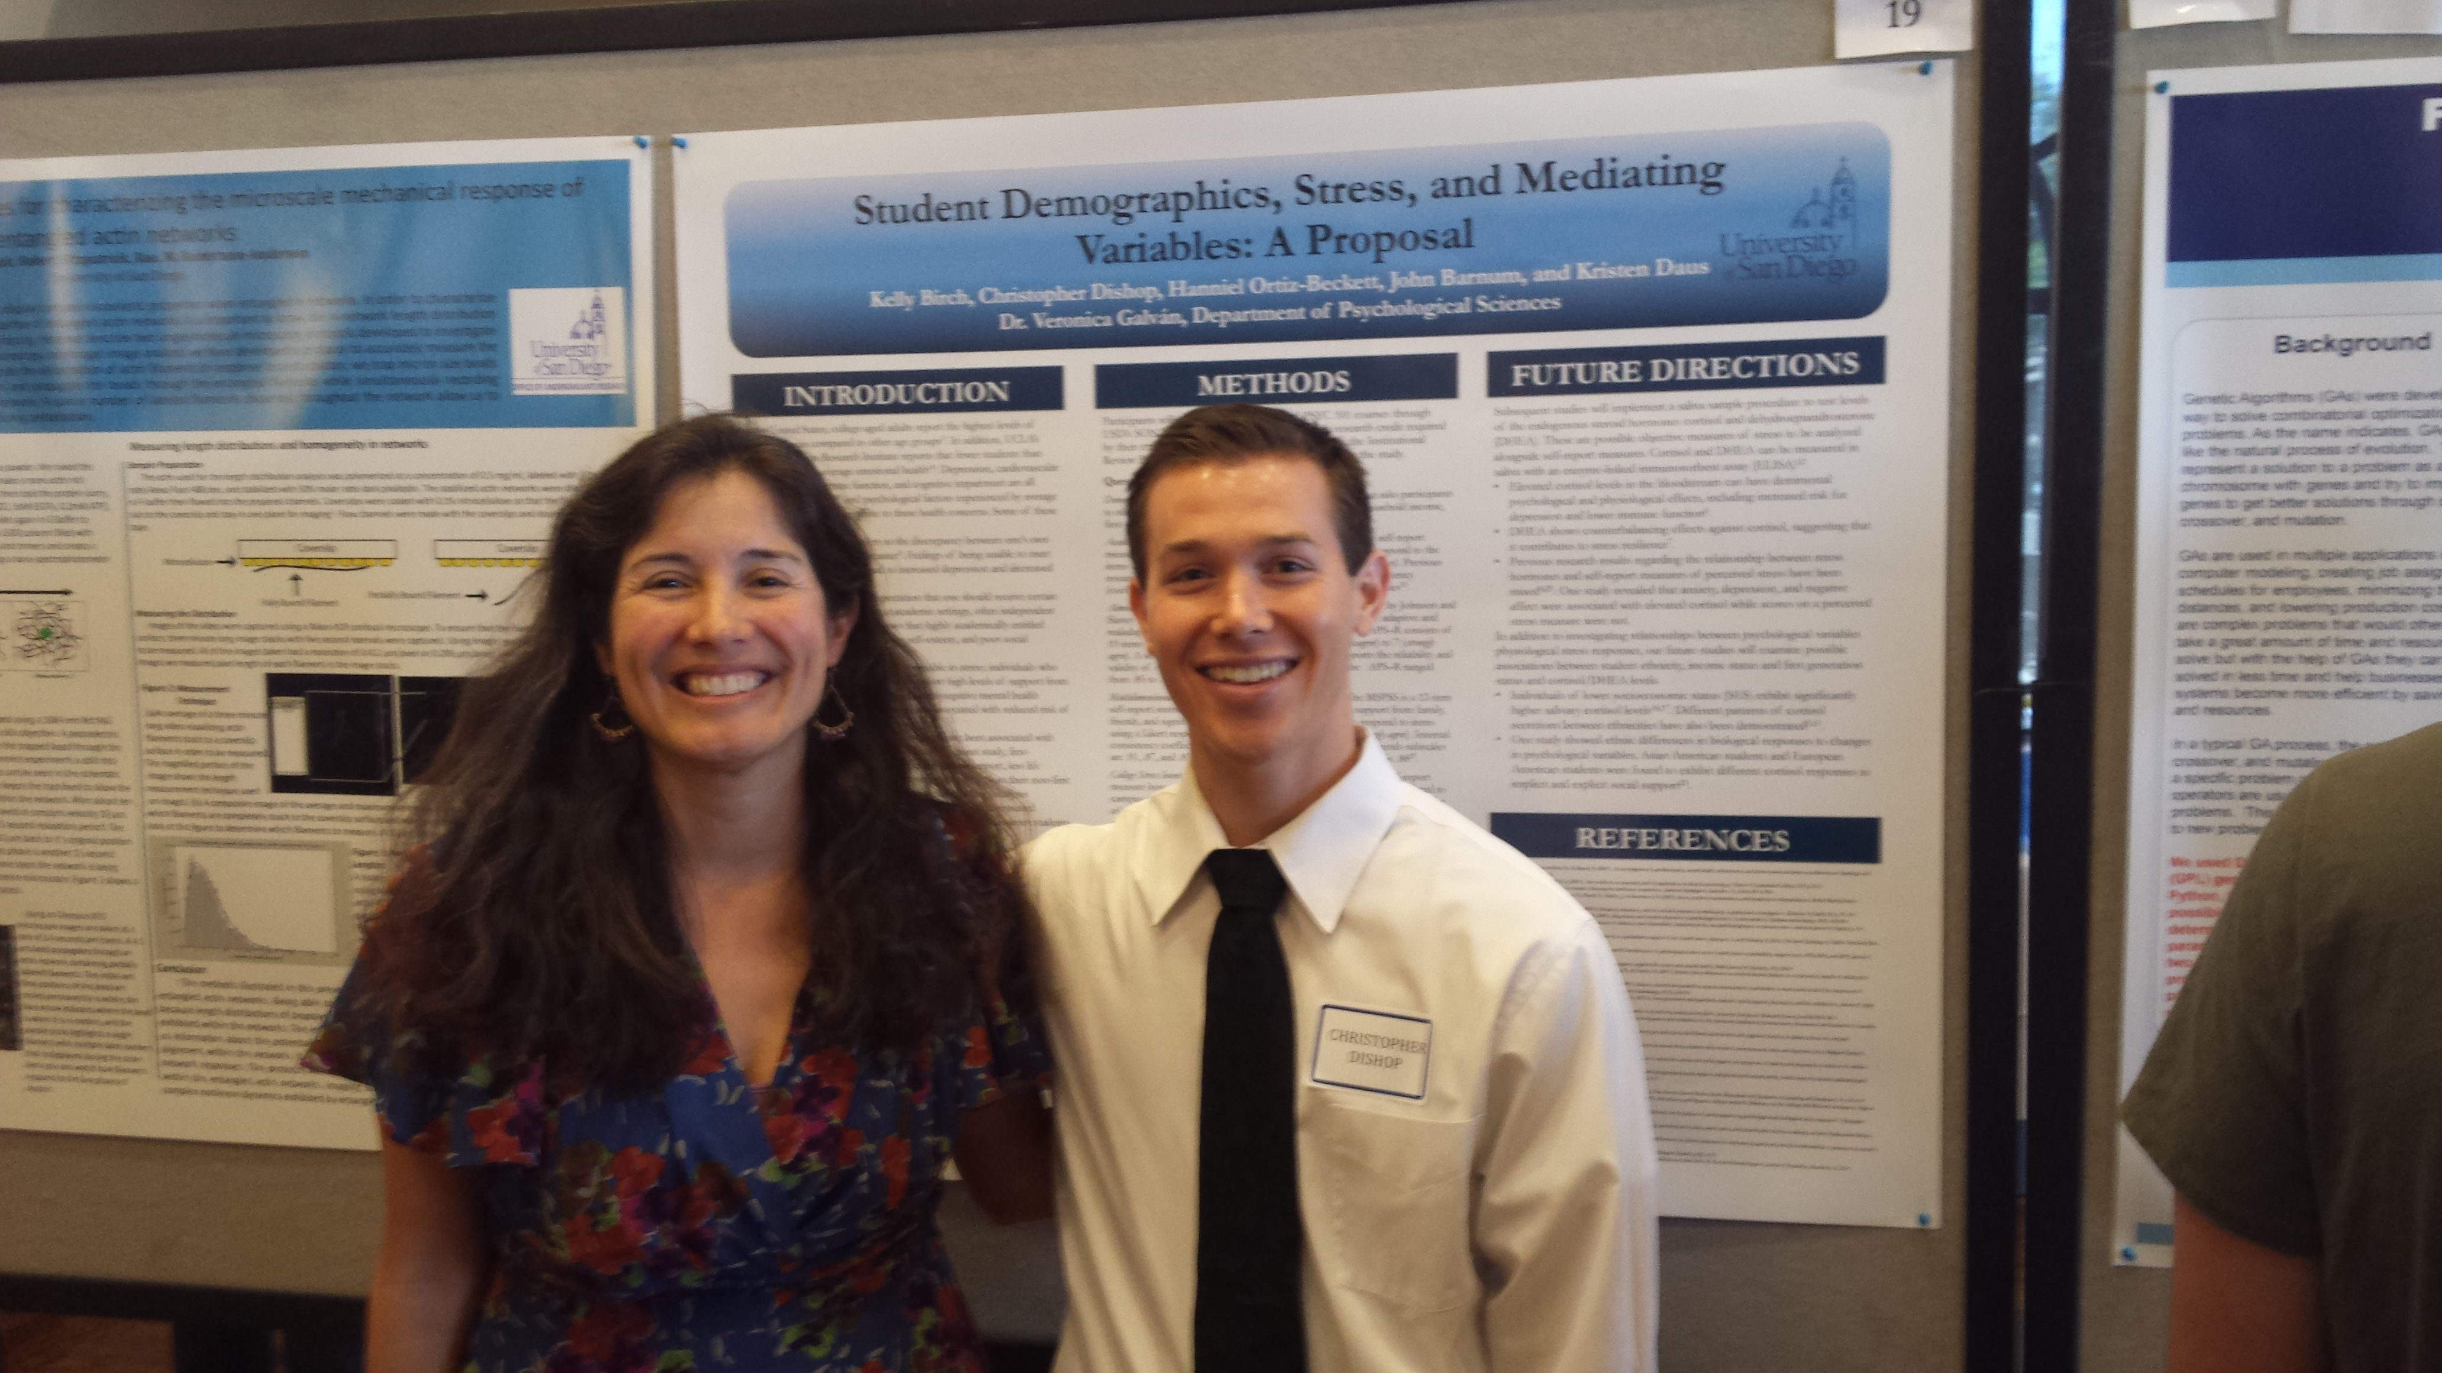
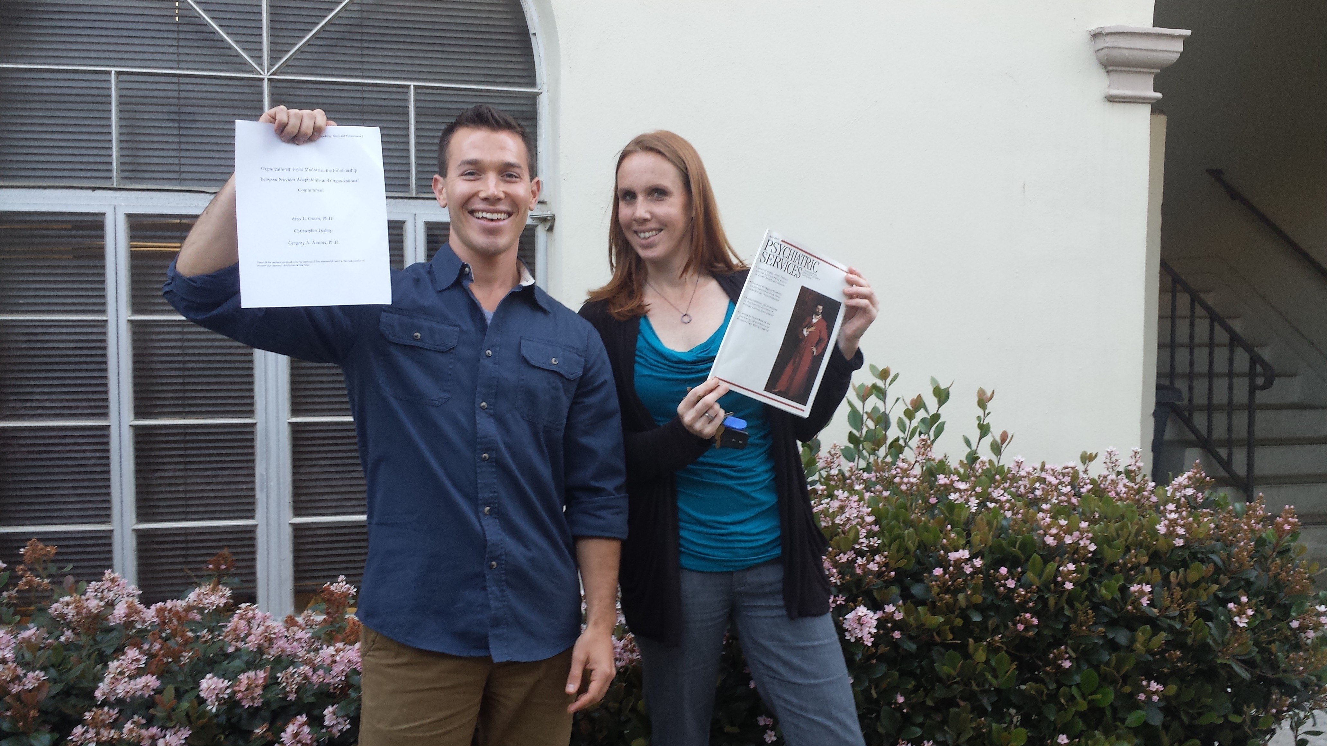
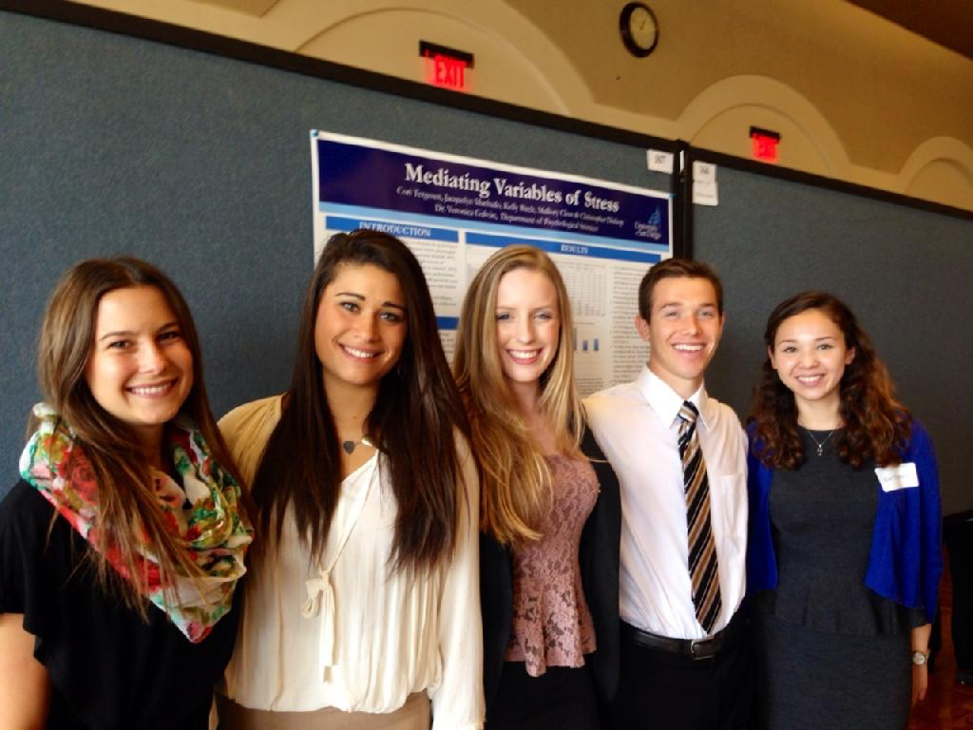
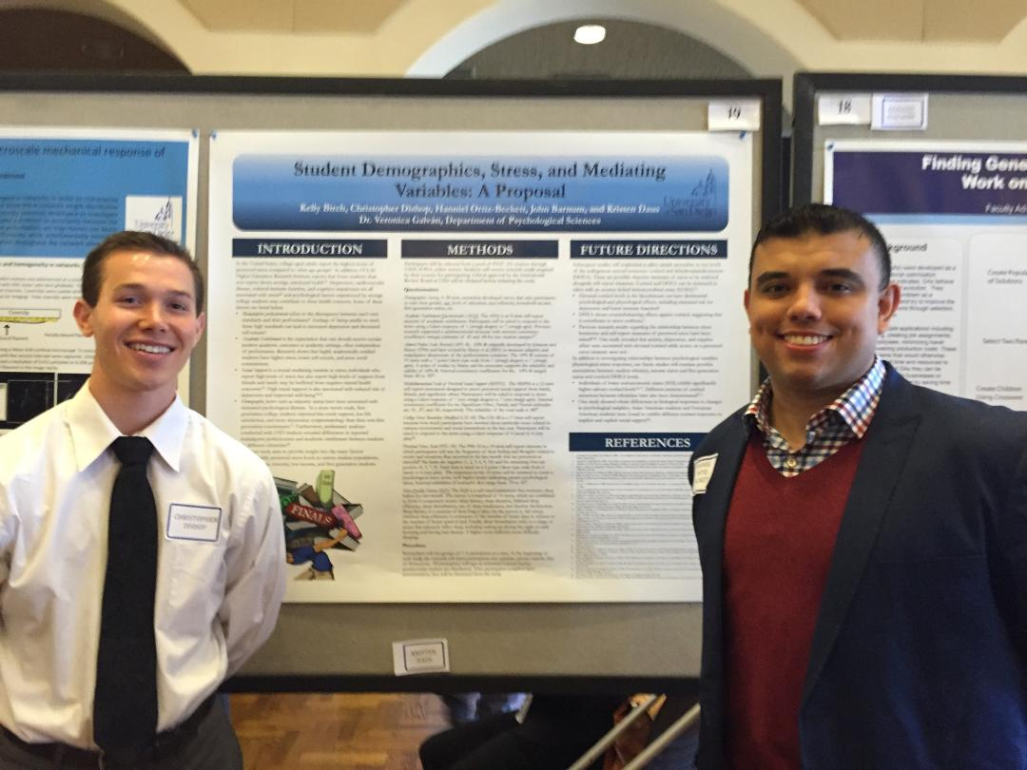

Slide 99
dishopch@msu.edu

